Slide 1

Child Nutrition Program
Christina Pitsenberger
Director – Child Nutrition Program

Slide 2

The mission of the Child Nutrition Program, in partnership with our school community, is to provide healthy and balanced meals by offering excellent service, while promoting nutrition and wellness.

Slide 3
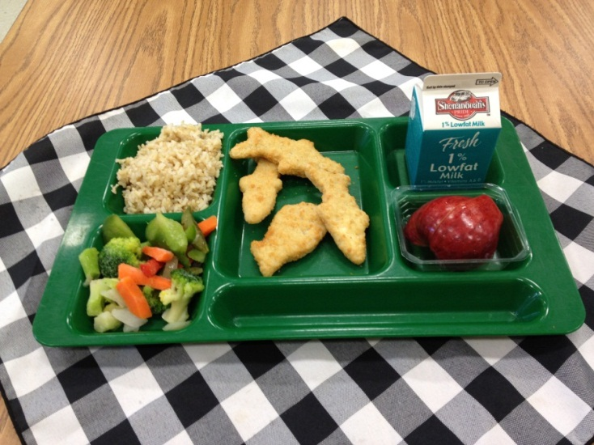

24 cafeterias serving 26 schools.
In 2011-12, CNP served 299,758 breakfast and 1,150,624 lunches.
Provide meals to Headstart at 4 locations.
Provide catering service to include the CFA summer event.

Slide 4

Quality Assurance
Employee Education
    Nutrition and Wellness
      ACAC Medical Weight Loss Program
      Step Class
      Various speakers at employee meetings
      School Nutrition Association – local chapter
      Annual All Employee Orientation Day
        Customer Service
        Updates on any local, state or federal regulations
        Building Skills
        Food Safety/Sanitation
        Nutrition and Wellness
        Personal well-being
        Five Star Quality & Performance Inspection
            Tool used during site visits to evaluate the overall school cafeteria operation.
            Identifying areas for improvement and acknowledging excellence where due.

Slide 5
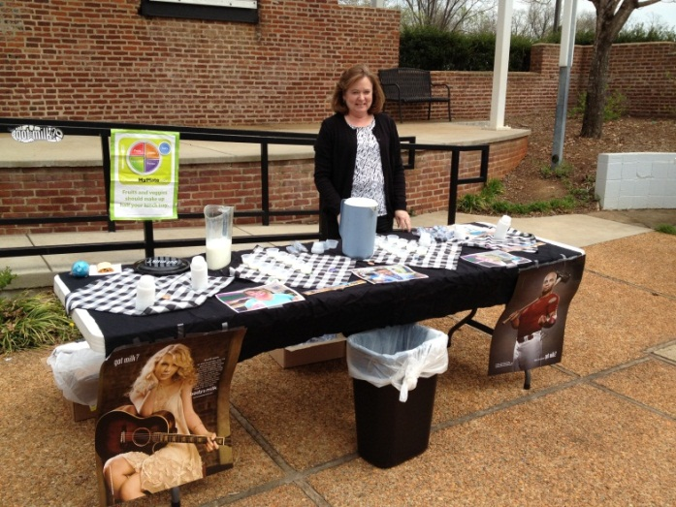
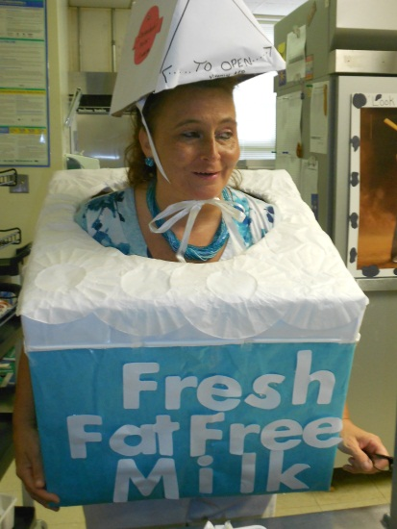

Promotions
National School Lunch Week
Farm to School Week
National Nutrition Month
CNP participates in a variety of school health fairs, school assemblies, and classroom education opportunities.

Slide 6
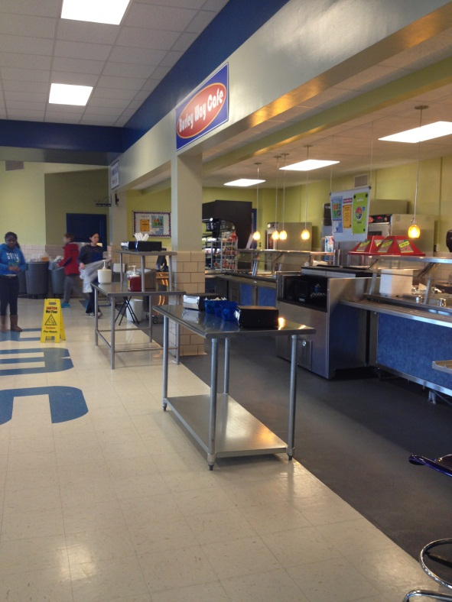
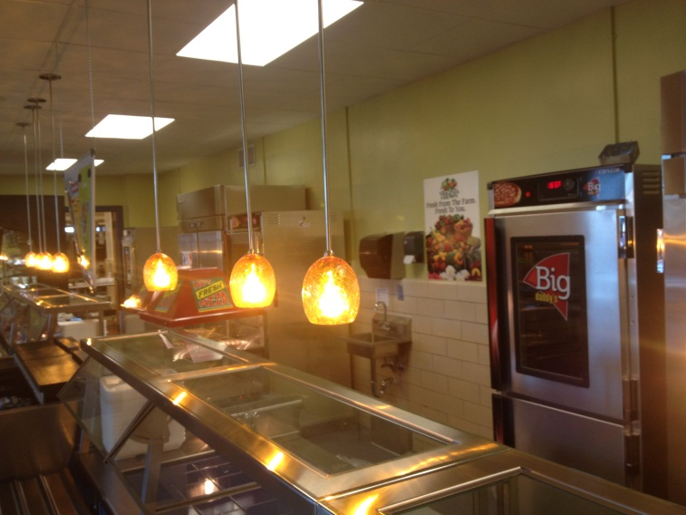
Updates
New School Meal Program Regulations
    Healthy, Hunger-Free Kids Act of 2010
    New Nutritional Standards and Meal Planning
    Paid Lunch Price Equity
New Online Payment System
    Option for parents to add monies to student’s meal account as well as view transactions
Equipment
    Upgrade to Burley
    WAHS – renovation
    Air Conditioning to cafeterias
Eye on Participation
    Overall decrease
      Decrease in full paid student meal
    participation
    Free-Reduced participation increase

Slide 7

2013-14 Budget
Revenue:
    47% of revenue is from Federal and State Funds
    53% of revenue is from Sales
Expenditures:
    52% personnel/benefits
    44% operating costs
    1% capital
    3% fund transfer

Slide 8
What happens if there is a 10% sequestration from the Federal Government?
Estimate $200,000 less in funding.
Adjust meal price accordingly. This could amount to an increase of up to $.33/meal if meal price is exclusive method.
Reduction in expenses, in combination with meal increase of less than $.33/meal.
Fund reserve

